Slide 1
Welcome, Families! Mrs. Murdy’s 6th Grade Social Studies
If you would like to share any information that will help me in teaching your child this year, please complete the index card on the desk and include the following: Child’s first and last name, Class period (1, 2, 3, or 5) Please leave on the desk or place in the basket near the door. Thank you!

Slide 2
About Mrs. Murdy
13th year of teaching
Experience in 4th, 5th, and 6th grades.
Teaching in Wake County since 2011, including Dillard Drive Middle, Alston Ridge Elementary, and Apex Elementary
Originally from Ocean Township, NJ
Moved to Apex in 2005
Married with 2 sons, Sean and Connor (Senior and freshman at Apex Friendship High School)

Slide 3
Bobcat Team Schedule:
(Locker Break)
Homeroom 8:00-8:15
Core 1 8:15-9:15
Core 2 9:18-10:18
(Locker break)
Core 3 10:21-11:21
Lunch 11:21-11:41
Leopard Time 11:41-12:11
Core 4 12:14-1:14
(Locker break)
Elective 1 1:19-2:08
Elective 2 2:11-3:00

Slide 4
Staying Organized
Arrival routine:
Read the board when arriving each day
Record homework and update TOC.
Complete warm up work
Table of Contents, or TOC (Students add page numbers and in place in correct order.)
Binder includes all class notes/activities (clean out at the end of each quarter)

Slide 5
Homework:
Not typically assigned daily in Social Studies.
Students, however, are expected to:
Review notes daily.
Study for quizzes/tests.
Complete some short assignments and project work at home.

Slide 6
Major Differences Between Elementary & Middle School
Team model/Teachers collaborate and are responsible for 120+ students.
Increased expectation to check websites and online tools
PBIS/Spots tickets
More student self-discipline & responsibility.
Conferences only scheduled as needed.
Grades are reported on a 10 point scale rather than a 1-4 grading scale. (Powerschool converts to a percentage.)

Slide 7
How can your student succeed and feel confident in 6th grade?
*Bookmark and check these sites often:
Bobcats Homework Calendar
Bobcats Team Website
Mrs. Murdy’s class website
Powerschool – Have your student start good habits early!
*Do a quick daily review and check of each notebook or binder. Students should avoid the quick “shove” of the loose paper!
*Use class time and Leopard time to actively participate and ask questions.

Slide 8
Grading
Major Assessments 25-50 points
Quizzes/projects 1-20 points
Classwork 1-15 points
Homework maximum of 1 point
The final quarter grade will be the total number of points earned divided by the total number of points possible.
One to two quizzes per unit
One final test or project per unit; at least two per quarter

Slide 9
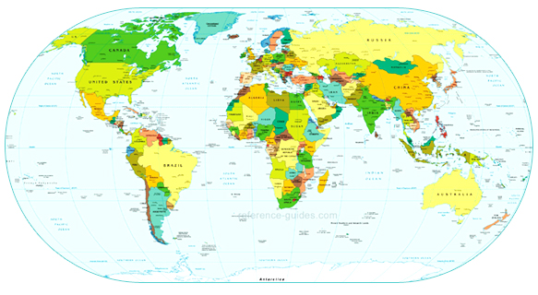
Major Units of Study
5 Themes of Geography
Geography of Ancient Civilizations
Religious Expansion and Influence on Ancient Civilizations
Achievements of Ancient Civilizations
Political and Government Structures of Ancient Civilizations
Economic Structures of Ancient Civilizations
Social Structures of Ancient Civilizations
Decline of Civilizations
Middle Ages, Renaissance and Reformation
We will focus on the ancient civilizations of:
The Americas, Egypt, Greece, Rome, Byzantine Empire, Middle East,
Pre-colonial Africa, South Asia, China, Japan, and Korea.

Slide 10
What does “GRAPES” mean in Social Studies?

Slide 11
Geography: How climate and landscape affect lifestyle
• What were some of the key geographical features or landforms in this area?
• What resources were available for clothing, building and trade?
• Was the civilization isolated, or was it open to cultural exchange or invasion?
• How were people affected by the environment, and how did they shape the environment?

Slide 12
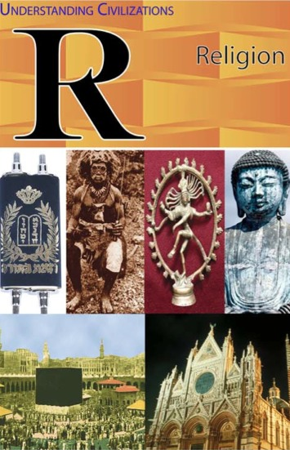
Religion: Society’s beliefs about morals and the afterlife
• What were the rules people believed they should live by?
• What factors contributed to the development of this religion or belief system?
• How did these religious ideas affect different aspects of daily life?

Slide 13
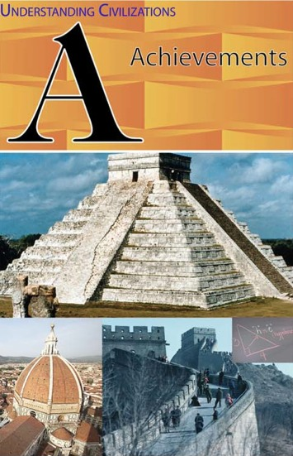
Achievements: The lasting works of a society
• What things were created to last?
• What was the significance of these achievements?
• Which ideas, if any, still affect our lives today?

Slide 14
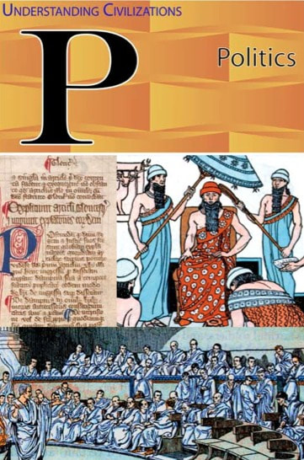
Political System: Who runs a society, and how do they do it?
• What things were created to last?
• What was the significance of these achievements?
• Which ideas, if any, still affect our lives today?

Slide 15
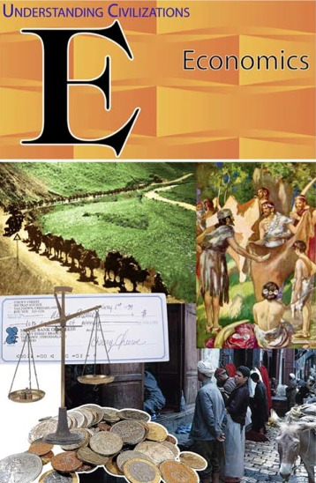
Economics: How a society uses its scarce resources
• What were the most valuable resources in the society?
• How were those resources distributed? (What type of economic system was in place?)
• What were the key products that this civilization created, grew, or traded?
• To what extent was the economy local? Global?

Slide 16
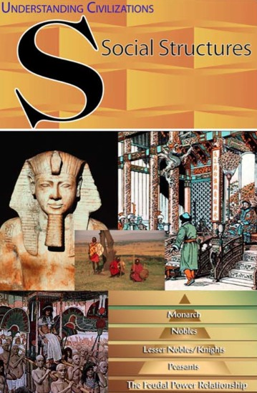
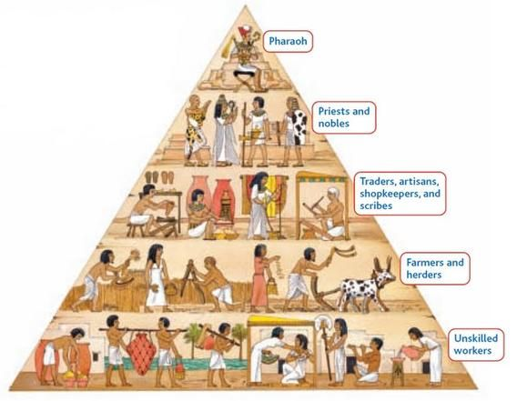
Social Structure: The different levels or classes in a society
• Who were the “most important” people in the society? What did they do?
• Who was at the bottom of the heap? Why?

Slide 17
Interim Reports
Interim reports are sent home mid-way through each nine week quarter.
The grade on the interim report is not permanent and gives each child an opportunity to see strengths and areas in need of growth.
Powerschool and interim reports are our primary tools to share grades.

Slide 18
Communication Email: nmurdy@wcpss.net Class website: http://mrsmurdy.weebly.com (linked to Bobcats/MPMS site) Bobcats Team Remind: *Enter this number: 81010, then text: @f3gfbk *Most of all, I encourage your students to try to first communicate directly with their teachers. Taking ownership over their own experiences will help them grow!

Slide 19
Thank you for visiting our class this evening!
I am thrilled to teach your children this year!

